Slide 1
Finla report
Team 1
Group 6

Slide 2

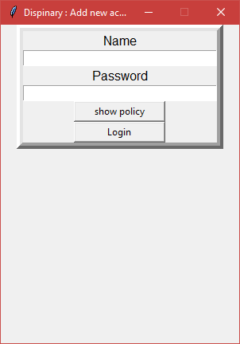
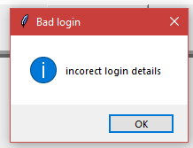
Program progess
Login screen
Will requers a users first name and password
Will open the main added displany arction screen if suffely loged in
Shows error message if incoret name or password enter
Has a policy button to show the compnays policy

Slide 3
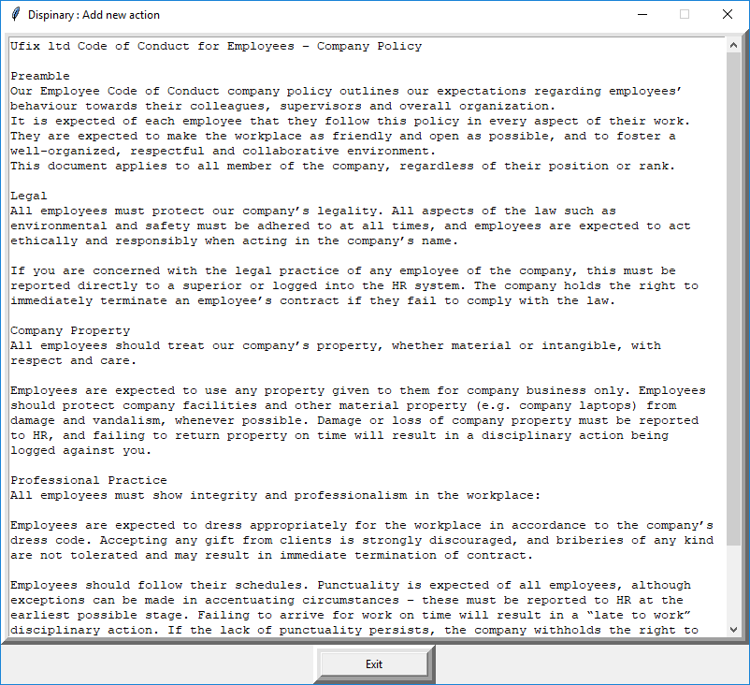
Program progess
Poilcy screen
Shows company pilcy
DOSE NOT WORK??

Slide 4
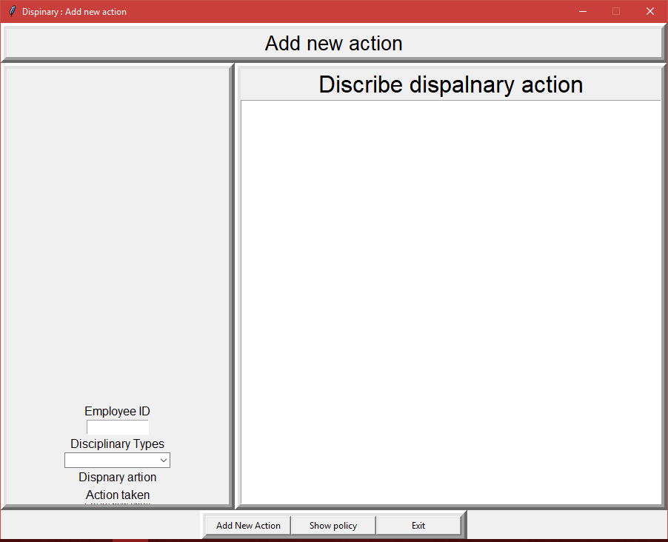
Program progess
Displainary action

Slide 5
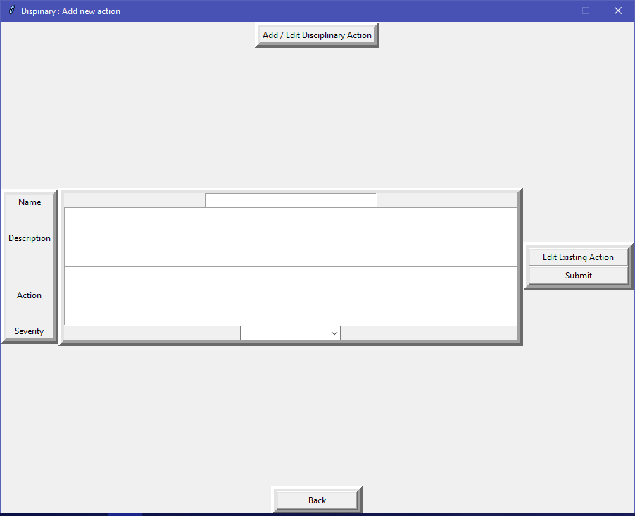
Program progess
Displainary action

Slide 6
Testing
Displainary action

